Slide 1
Special functions and Integral Transforms MAT 241
Dr. Mohamed Adel
mohamed.adel@aiet.edu.eg

Slide 2
Lecture8: Fourier Transform Properties

Slide 3
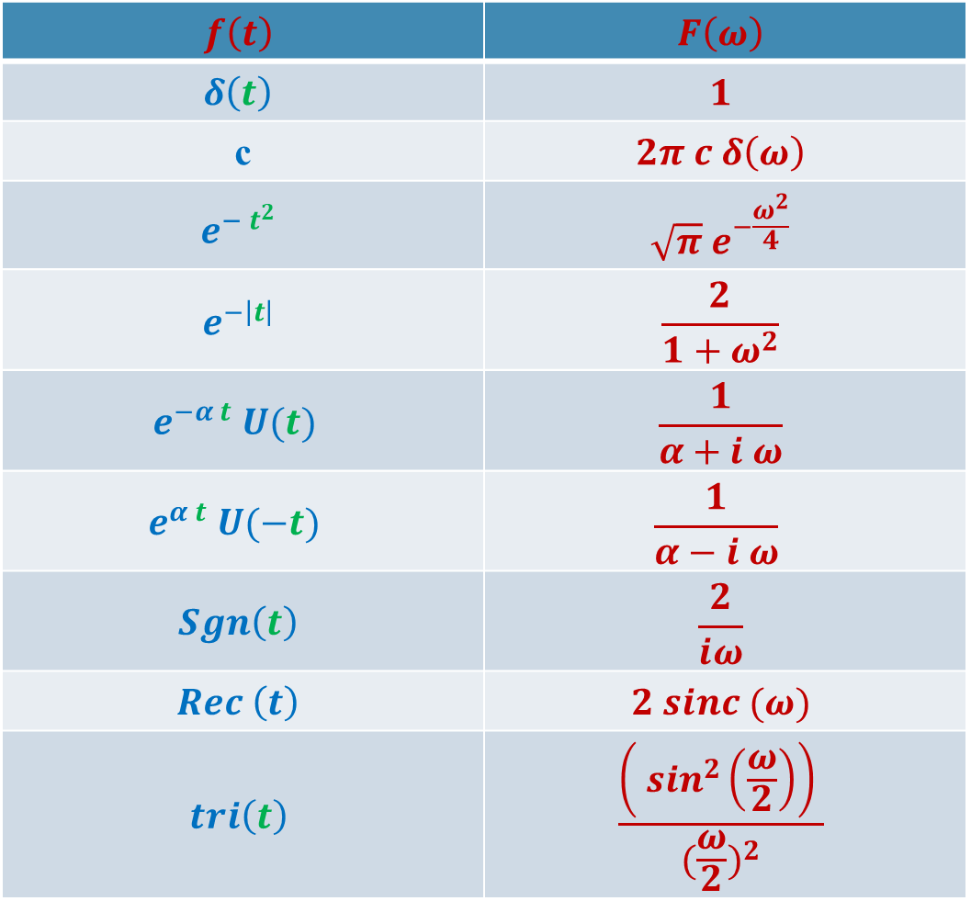
Summary of F.T. of important functions
$$f\left(t\right)$$ | $$F\left(ω\right)$$
$$δ\left(t\right)$$ | $$1$$
c | $$2π c δ\left(ω\right)$$
$$e^{− t^{2}}$$ | $$\sqrt{π} e^{−\frac{ω^{2}}{4}}$$
$$e^{−\left|t\right|}$$ | $$\frac{2}{1+ω^{2}}$$
$$e^{−α t} U(t)$$ | $$\frac{1}{α+i ω}$$
$$e^{α t} U(−t)$$ | $$\frac{1}{α−i ω}$$
$$Sgn\left(t\right)$$ | $$\frac{2}{iω}$$
$$Rec \left(t\right)$$ | $$2 sinc (ω)$$
$$tri\left(t\right)$$ | $$\frac{\left( \sin^{2}\left(\frac{ω}{2}\right)\right) }{{(\frac{ω}{2})}^{2}}$$

Slide 4


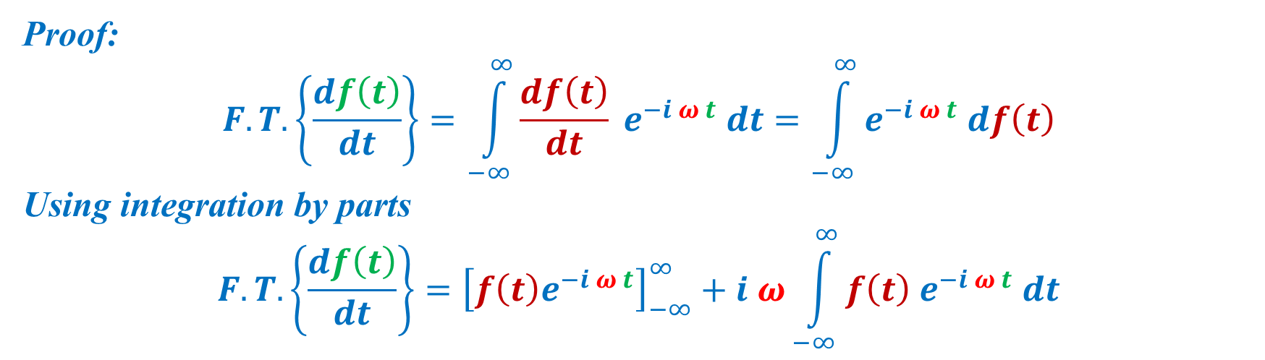


6) Differentiation in time (physical) domain:
$$F.T. \left\{f\left(t\right)\right\}⟺F(ω)$$
$$F.T. \left\{\frac{df\left(t\right)}{dt}\right\}⟺i ω F(ω)$$
Proof:
$$F.T. \left\{\frac{df\left(t\right)}{dt}\right\}=\int_{−∞}^{∞}{\frac{df\left(t\right)}{dt} e^{−i ω t} dt}=\int_{−∞}^{∞}{e^{−i ω t} df\left(t\right)}$$
Using integration by parts
$$F.T. \left\{\frac{df\left(t\right)}{dt}\right\}={\left[f\left(t\right)e^{−i ω t}\right]}_{−∞}^{∞}+i ω\int_{−∞}^{∞}{f\left(t\right) e^{−i ω t} dt}$$
$$0$$

Slide 5
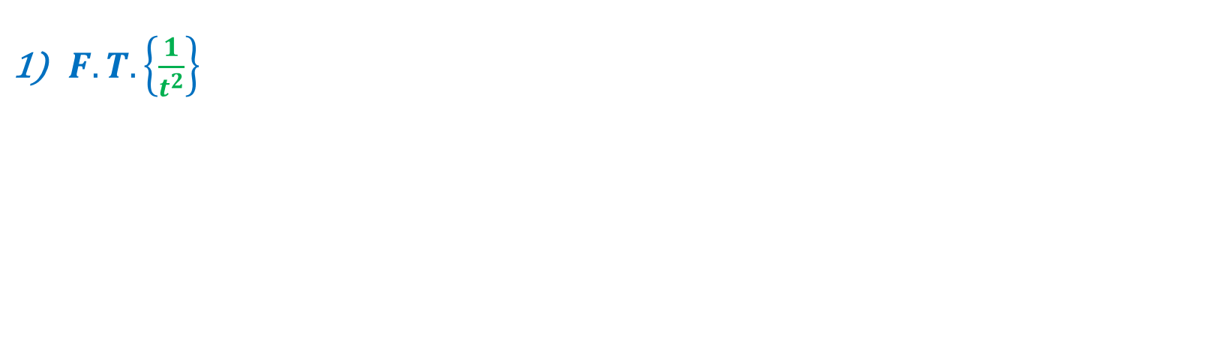


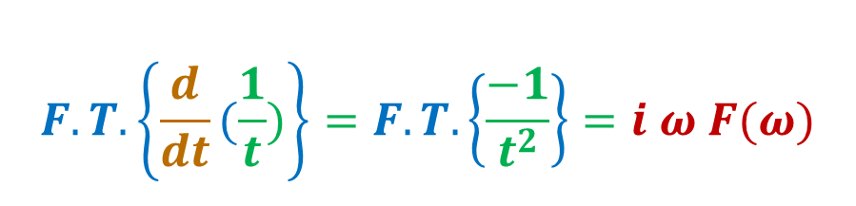

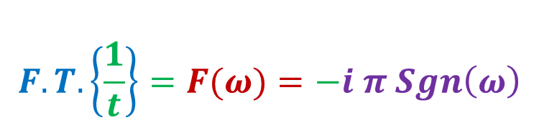
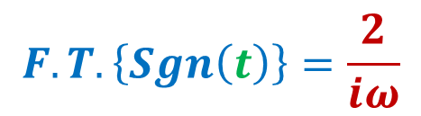
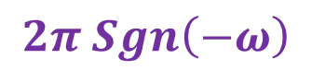

Example:
$F.T. \left\{\frac{1}{t^{2}}\right\}$
$$F.T. \left\{Sgn\left(t\right)\right\}=\frac{2}{iω}$$
$$2π$$
$$ω →t$$
$$t →−ω$$
$$\frac{2}{it}$$
$$2π Sgn\left(−ω\right)$$
$$F.T. \left\{\frac{1}{t}\right\}=F(ω)=−i π Sgn\left(ω\right)$$
$$F.T. \left\{\frac{d}{dt}(\frac{1}{t})\right\}=F.T. \left\{\frac{−1}{t^{2}}\right\}=i ω F(ω)$$

Slide 6
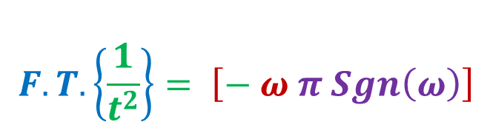
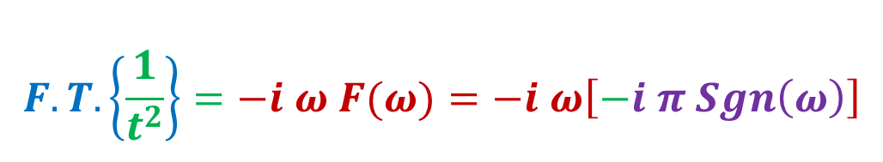
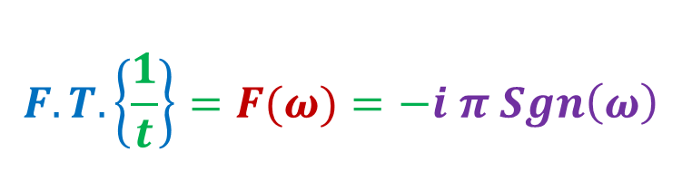
$$F.T. \left\{\frac{1}{t}\right\}=F(ω)=−i π Sgn\left(ω\right)$$
$$F.T. \left\{\frac{1}{t^{2}}\right\}=−i ω F(ω)=−i ω\left[−i π Sgn\left(ω\right)\right]$$
$$F.T. \left\{\frac{1}{t^{2}}\right\}= \left[− ω π Sgn\left(ω\right)\right]$$

Slide 7



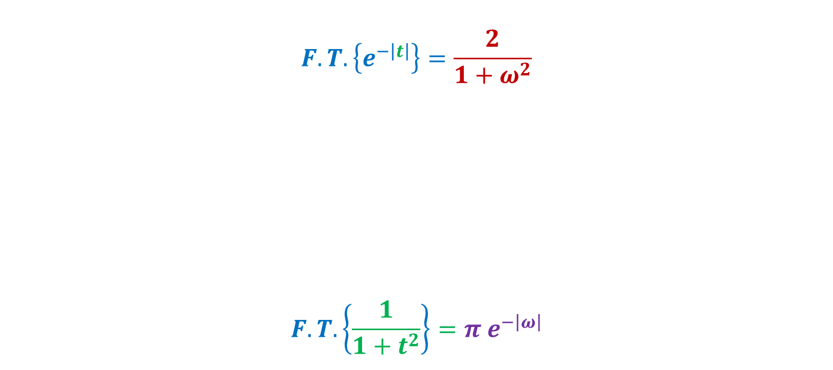

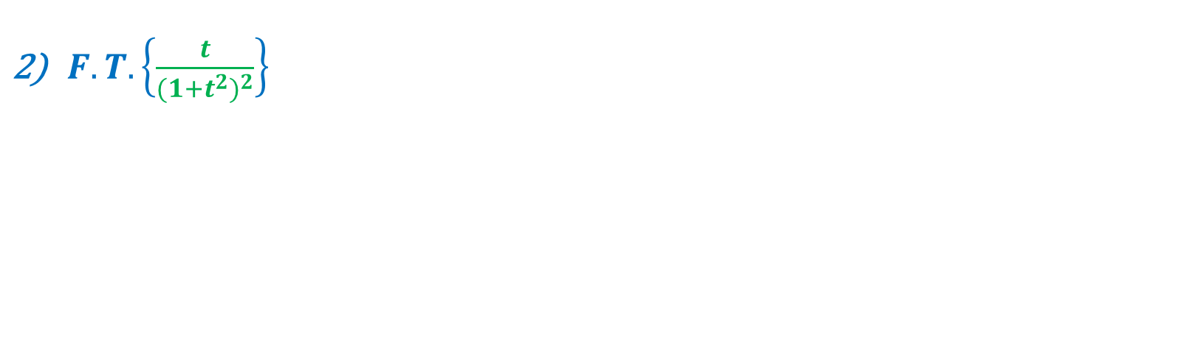
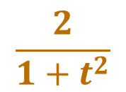
Example:
$F.T. \left\{\frac{t}{{{(1+t}^{2})}^{2}}\right\}$
$$F.T. \left\{e^{−\left|t\right|}\right\}=\frac{2}{1+ω^{2}}$$
$$F.T. \left\{\frac{1}{1+t^{2}}\right\}=π e^{−\left|ω\right|}$$
$$2π$$
$$ω →t$$
$$t →−ω$$
$$\frac{2}{1+t^{2}}$$
$$2π e^{−\left|ω\right|}$$

Slide 8
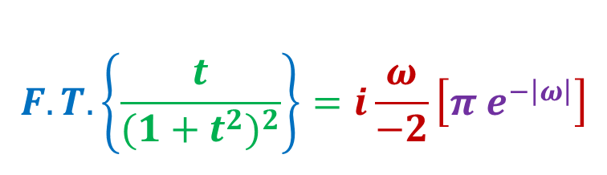
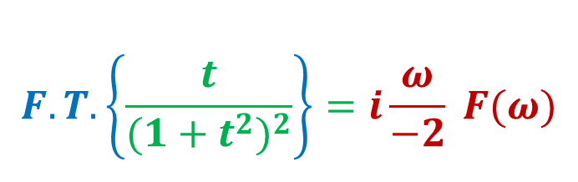
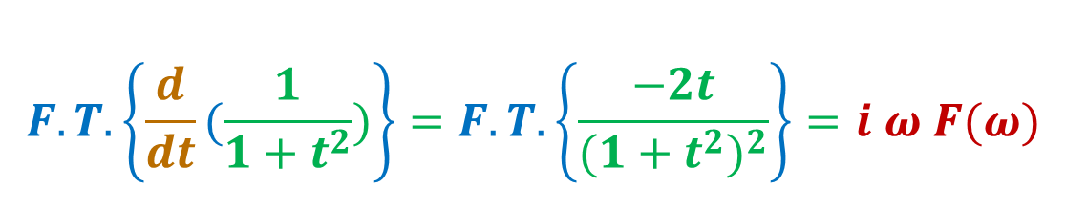
$$F.T. \left\{\frac{d}{dt}(\frac{1}{1+t^{2}})\right\}=F.T. \left\{\frac{−2t}{{{(1+t}^{2})}^{2}}\right\}=i ω F(ω)$$
$$F.T. \left\{\frac{t}{{{(1+t}^{2})}^{2}}\right\}=i\frac{ω}{−2} F(ω)$$
$$F.T. \left\{\frac{t}{{{(1+t}^{2})}^{2}}\right\}=i\frac{ω}{−2}\left[π e^{−\left|ω\right|}\right]$$

Slide 9
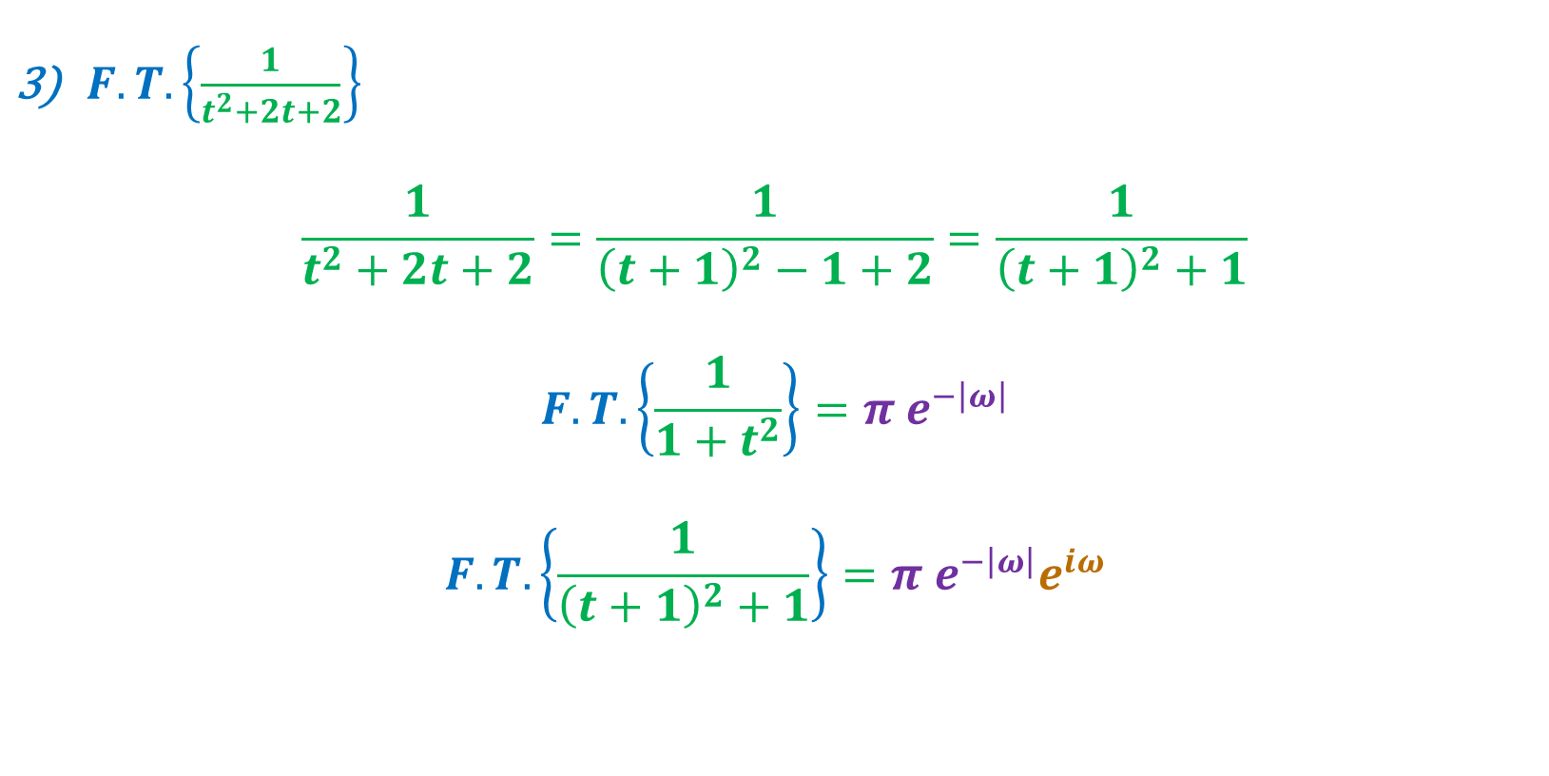
Example:
$F.T. \left\{\frac{1}{t^{2}+2t+2}\right\}$
$$\frac{1}{t^{2}+2t+2}=\frac{1}{{\left(t+1\right)}^{2}−1+2}=\frac{1}{{\left(t+1\right)}^{2}+1}$$
$$F.T. \left\{\frac{1}{1+t^{2}}\right\}=π e^{−\left|ω\right|}$$
$$F.T. \left\{\frac{1}{{\left(t+1\right)}^{2}+1}\right\}=π e^{−\left|ω\right|}e^{iω}$$

Slide 10


7) Differentiation in frequency domain:
$$F.T. \left\{f\left(t\right)\right\}⟺F(ω)$$
$$F.T. \left\{−it f\left(t\right)\right\}⟺\frac{d}{dω}F(ω)$$
Proof:
$$F(ω)=\int_{−∞}^{∞}{{f\left(t\right) e}^{−i ω t} dt}$$
$$\frac{d}{dω}F\left(ω\right)=\int_{−∞}^{∞}{{f\left(t\right)∗−it e}^{−i ω t} dt}$$

Slide 11
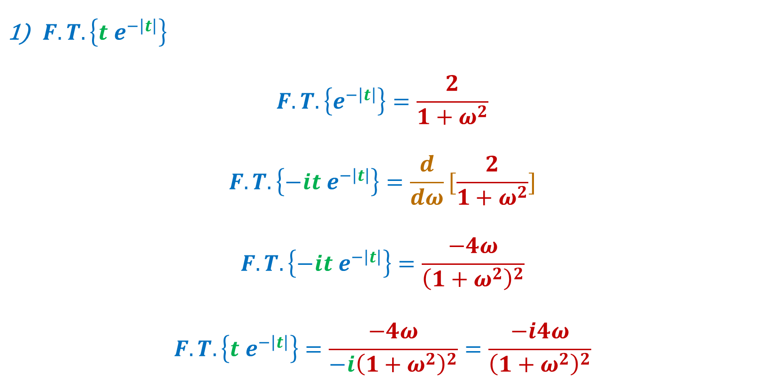
Example:
$F.T. \left\{t{ e}^{−\left|t\right|}\right\}$
$$F.T. \left\{e^{−\left|t\right|}\right\}=\frac{2}{1+ω^{2}}$$
$$F.T. \left\{−it e^{−\left|t\right|}\right\}=\frac{d}{dω}[\frac{2}{1+ω^{2}}]$$
$$F.T. \left\{−it e^{−\left|t\right|}\right\}=\frac{−4ω}{{\left(1+ω^{2}\right)}^{2}}$$
$$F.T. \left\{t e^{−\left|t\right|}\right\}=\frac{−4ω}{−i{\left(1+ω^{2}\right)}^{2}}=\frac{−i4ω}{{\left(1+ω^{2}\right)}^{2}}$$

Slide 12
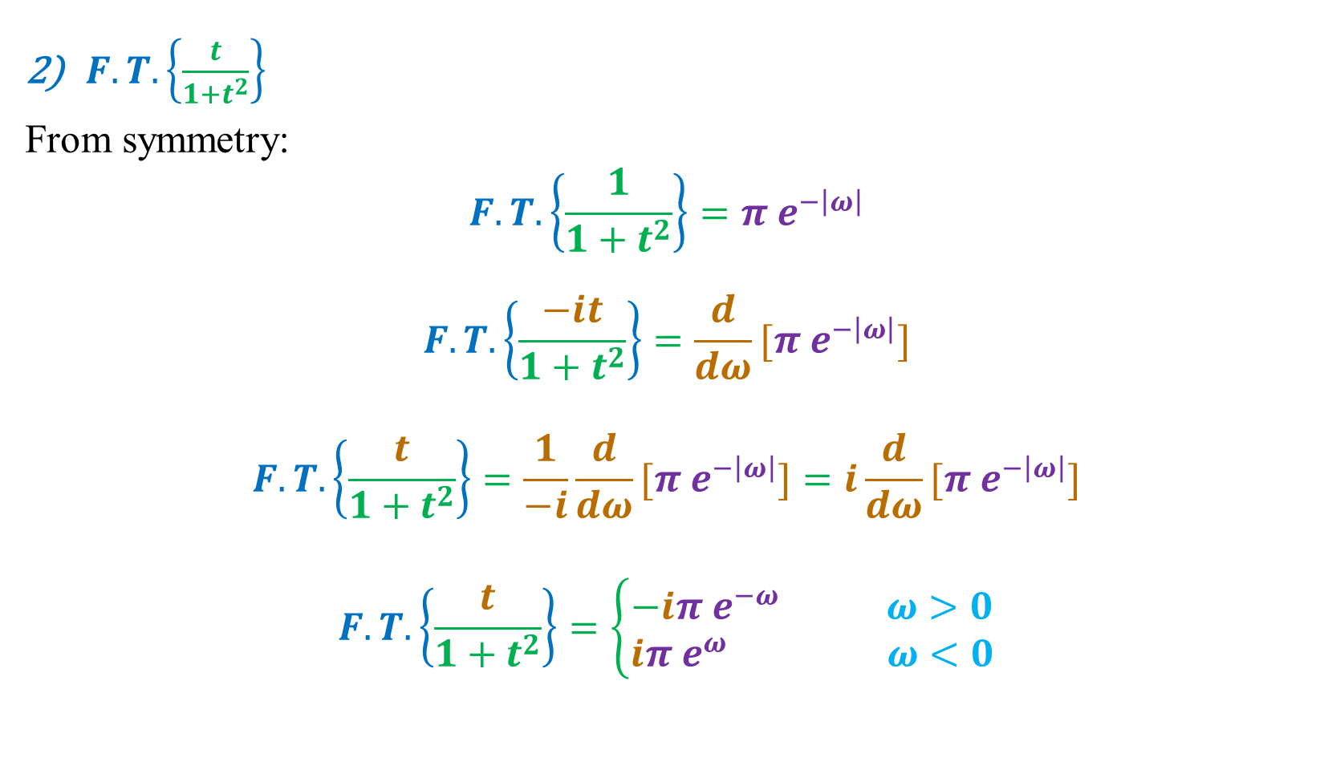
Example:
$F.T. \left\{\frac{t}{1+t^{2}}\right\}$
From symmetry:
$$F.T. \left\{\frac{1}{1+t^{2}}\right\}=π e^{−\left|ω\right|}$$
$$F.T. \left\{\frac{−it}{1+t^{2}}\right\}=\frac{d}{dω}[π e^{−\left|ω\right|}]$$
$$F.T. \left\{\frac{t}{1+t^{2}}\right\}=\frac{1}{−i}\frac{d}{dω}[π e^{−\left|ω\right|}]=i\frac{d}{dω}[π e^{−\left|ω\right|}]$$
$$F.T. \left\{\frac{t}{1+t^{2}}\right\}=\left\{\begin{aligned}−iπ e^{−ω} ω>0 \\ iπ e^{ω} ω<0\end{aligned}\right.$$

Slide 13
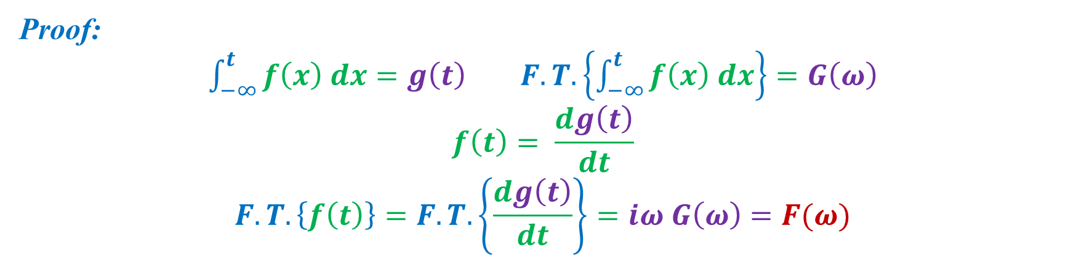
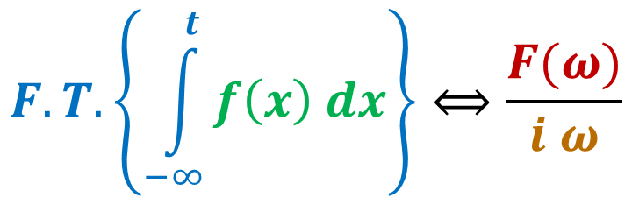
8) Integration in time (physical) domain:
$$F.T. \left\{f\left(t\right)\right\}⟺F(ω)$$
$$F.T. \left\{\int_{−∞}^{t}{f\left(x\right) dx}\right\}⟺\frac{F(ω)}{i ω}$$
Proof:
$\int_{−∞}^{t}{f\left(x\right) dx}=g\left(t\right)$ $F.T. \left\{\int_{−∞}^{t}{f\left(x\right) dx}\right\}=G\left(ω\right)$
$$f\left(t\right)= \frac{dg\left(t\right)}{dt}$$
$$F.T. \left\{f\left(t\right)\right\}=F.T. \left\{\frac{dg\left(t\right)}{dt}\right\}=iω G\left(ω\right)=F(ω)$$

Slide 14
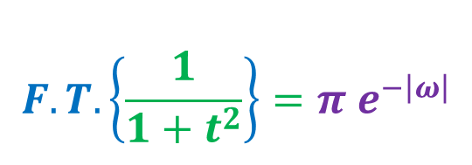
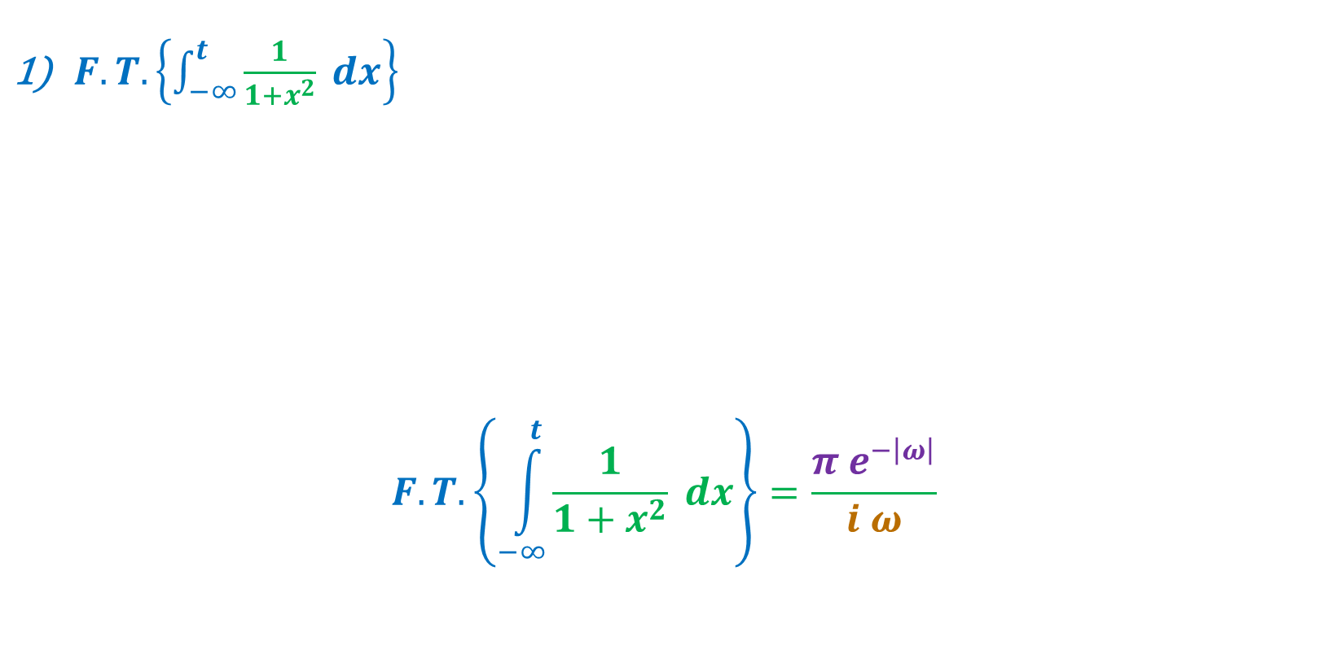
Example:
$F.T. \left\{\int_{−∞}^{t}{\frac{1}{1+x^{2}} dx}\right\}$
$$F.T. \left\{\int_{−∞}^{t}{\frac{1}{1+x^{2}} dx}\right\}=\frac{π e^{−\left|ω\right|}}{i ω}$$
$$F.T. \left\{\frac{1}{1+t^{2}}\right\}=π e^{−\left|ω\right|}$$

Slide 15
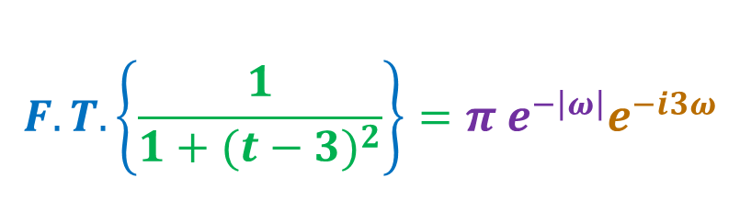
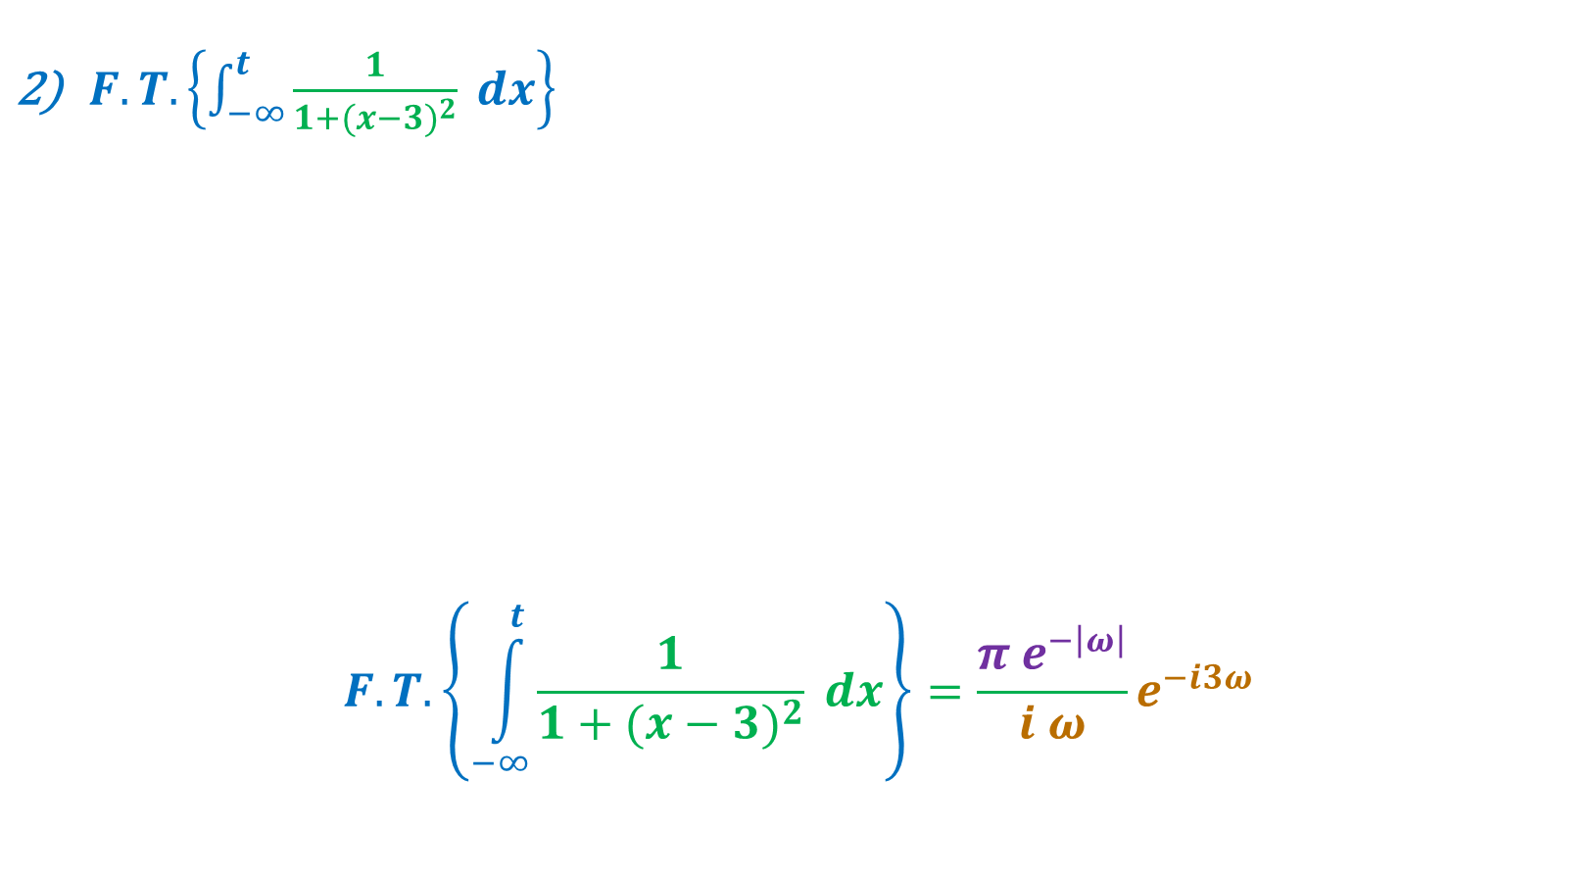
Example:
$F.T. \left\{\int_{−∞}^{t}{\frac{1}{1+({x−3)}^{2}} dx}\right\}$
$$F.T. \left\{\int_{−∞}^{t}{\frac{1}{1+{(x−3)}^{2}} dx}\right\}=\frac{π e^{−\left|ω\right|}}{i ω}e^{−i3ω}$$
$$F.T. \left\{\frac{1}{1+t^{2}}\right\}=π e^{−\left|ω\right|}$$
$$F.T. \left\{\frac{1}{1+{(t−3)}^{2}}\right\}=π e^{−\left|ω\right|}e^{−i3ω}$$

Slide 16
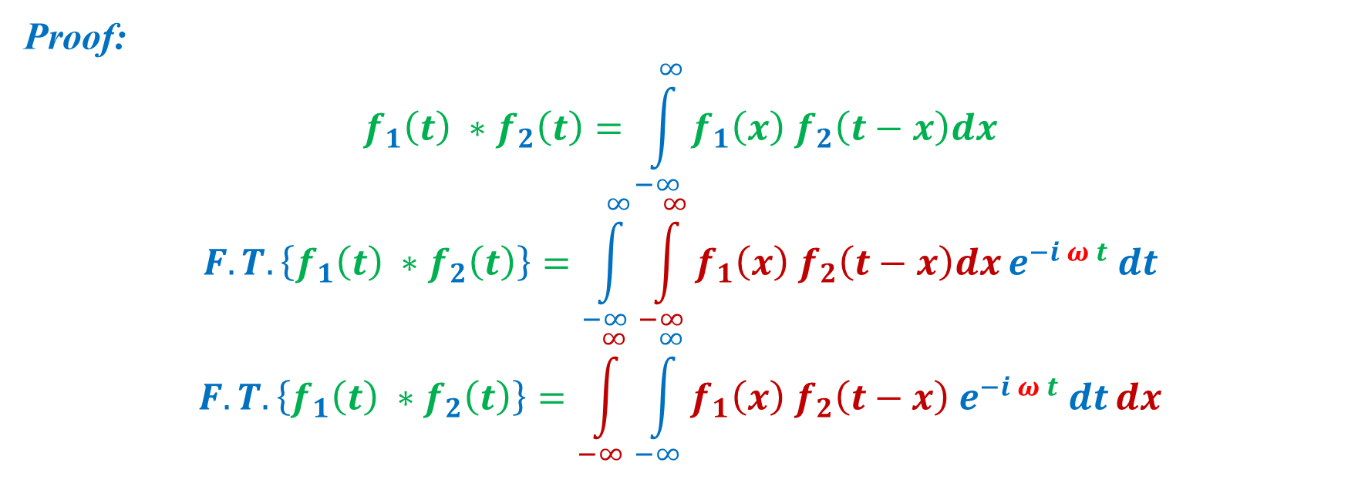
9) The convolution Theory:
$$F.T. \left\{f_{1}\left(t\right) ∗f_{2}\left(t\right)\right\}⟺F_{1} \left(ω\right){ F}_{2} (ω)$$
Proof:
$$f_{1}\left(t\right) ∗f_{2}\left(t\right)=\int_{−∞}^{∞}{f_{1}\left(x\right) f_{2}\left(t−x\right)dx}$$
$$F.T. \left\{f_{1}\left(t\right) ∗f_{2}\left(t\right)\right\}=\int_{−∞}^{∞}{\int_{−∞}^{∞}{f_{1}\left(x\right) f_{2}\left(t−x\right)dx}e^{−i ω t} dt}$$
$$F.T. \left\{f_{1}\left(t\right) ∗f_{2}\left(t\right)\right\}=\int_{−∞}^{∞}{\int_{−∞}^{∞}{{f_{1}\left(x\right) f_{2}\left(t−x\right) e}^{−i ω t} dt}dx}$$

Slide 17
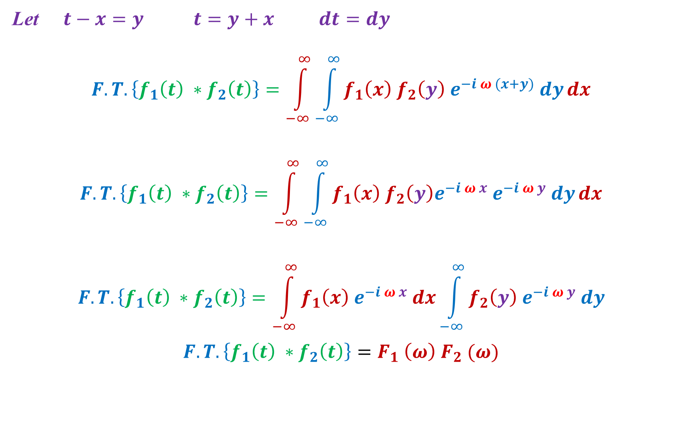
Let $t−x=y$ $t=y+x$ $dt=dy$
$$F.T. \left\{f_{1}\left(t\right) ∗f_{2}\left(t\right)\right\}=\int_{−∞}^{∞}{\int_{−∞}^{∞}{{f_{1}\left(x\right) f_{2}\left(y\right) e}^{−i ω (x+y)} dy}dx}$$
$$F.T. \left\{f_{1}\left(t\right) ∗f_{2}\left(t\right)\right\}=\int_{−∞}^{∞}{\int_{−∞}^{∞}{f_{1}\left(x\right) f_{2}\left(y\right)e^{−i ω x} e^{−i ω y} dy}dx}$$
$$F.T. \left\{f_{1}\left(t\right) ∗f_{2}\left(t\right)\right\}=\int_{−∞}^{∞}{f_{1}\left(x\right){ e}^{−i ω x} dx}\int_{−∞}^{∞}{f_{2}\left(y\right) e^{−i ω y} dy}$$
$$F.T. \left\{f_{1}\left(t\right) ∗f_{2}\left(t\right)\right\}=F_{1} \left(ω\right){ F}_{2} (ω)$$

Slide 18
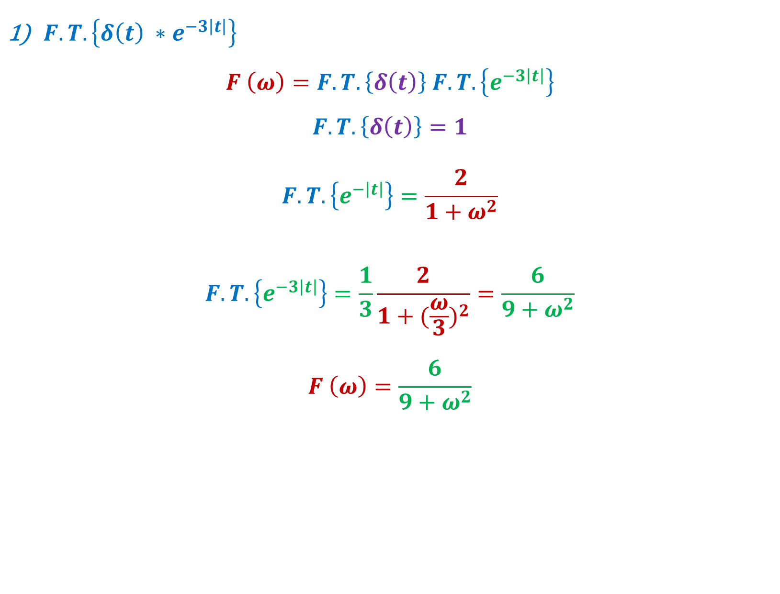
Example:
$F.T. \left\{δ\left(t\right) ∗e^{−3\left|t\right|}\right\}$
$$F \left(ω\right)=F.T. \left\{δ\left(t\right)\right\} F.T. \left\{e^{−3\left|t\right|}\right\}$$
$$F.T. \left\{δ\left(t\right)\right\}=1$$
$$F.T. \left\{e^{−\left|t\right|}\right\}=\frac{2}{1+ω^{2}}$$
$$F.T. \left\{e^{−3\left|t\right|}\right\}=\frac{1}{3}\frac{2}{1+{(\frac{ω}{3})}^{2}}=\frac{6}{9+ω^{2}}$$
$$F \left(ω\right)=\frac{6}{9+ω^{2}}$$

Slide 19
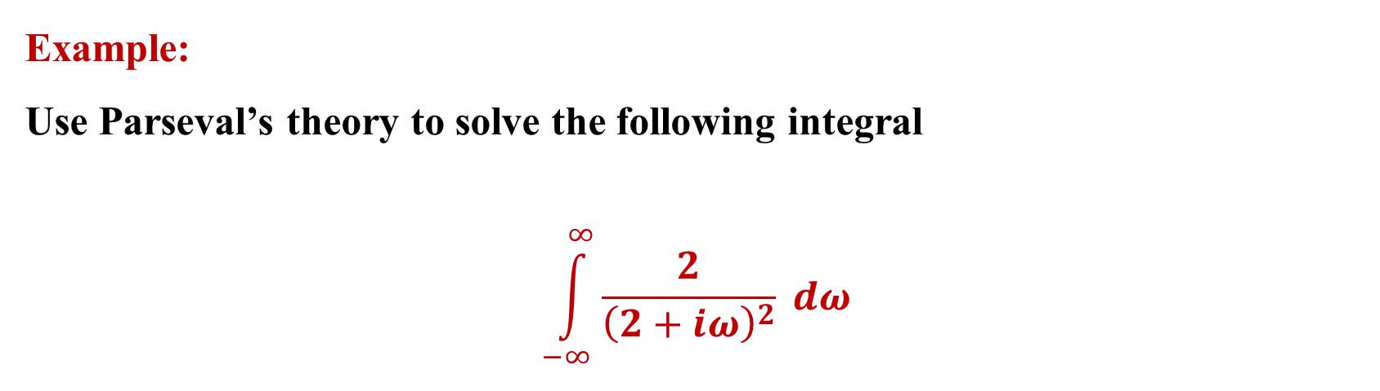
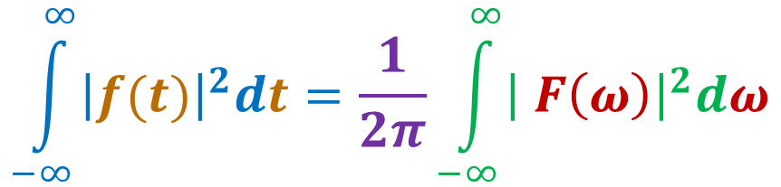
10) Parseval’s Theory:
$$\int_{−∞}^{∞}{{\left|f(t)\right|}^{2}dt}=\frac{1}{2π}\int_{−∞}^{∞}{{\left| F\left(ω\right)\right|}^{2}dω}$$
Example:
Use Parseval’s theory to solve the following integral
$$\int_{−∞}^{∞}{\frac{2}{{\left(2+iω\right)}^{2}} dω}$$

Slide 20
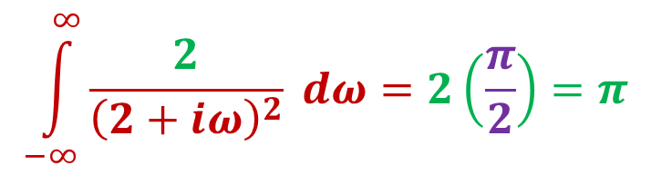
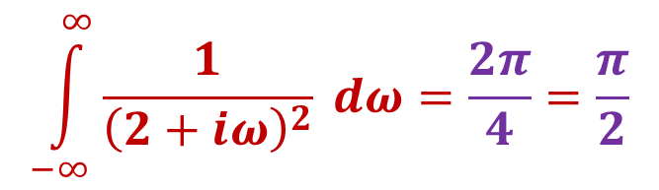
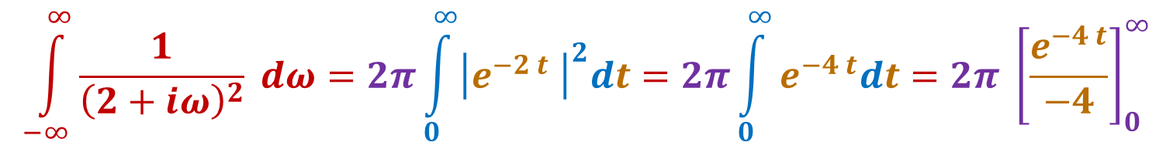
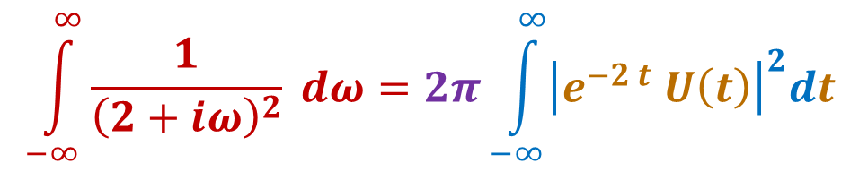
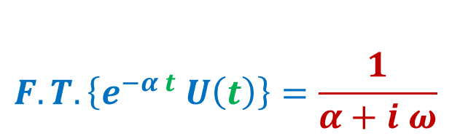
Solution:
$$F.T.\left\{e^{−α t} U\left(t\right)\right\}=\frac{1}{α+i ω}$$
$$\int_{−∞}^{∞}{\frac{1}{{\left(2+iω\right)}^{2}} dω}=2π\int_{−∞}^{∞}{{\left|e^{−2 t} U\left(t\right)\right|}^{2}dt}$$
$$\int_{−∞}^{∞}{\frac{1}{{\left(2+iω\right)}^{2}} dω}=2π\int_{0}^{∞}{{\left|e^{−2 t} \right|}^{2}dt}=2π\int_{0}^{∞}{e^{−4 t}dt}=2π {\left[\frac{e^{−4 t}}{−4}\right]}_{0}^{∞}$$
$$\int_{−∞}^{∞}{\frac{1}{{\left(2+iω\right)}^{2}} dω}=\frac{2π}{4}=\frac{π}{2}$$
$$\int_{−∞}^{∞}{\frac{2}{{\left(2+iω\right)}^{2}} dω}=2\left(\frac{π}{2}\right)=π$$

Slide 21
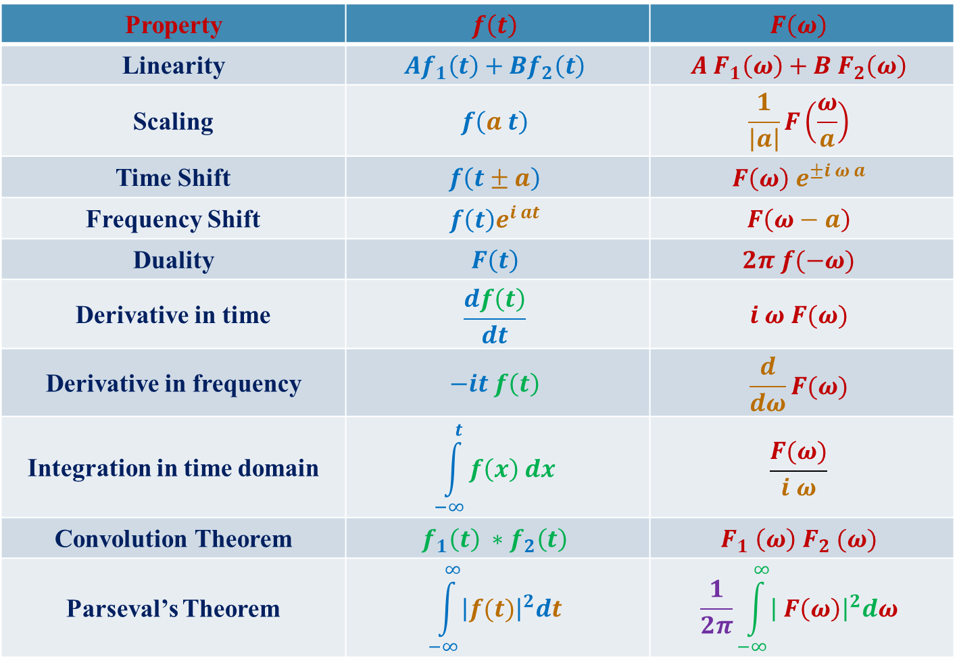
Summary of F.T. Properties
Property | $$f\left(t\right)$$ | $$F\left(ω\right)$$
Linearity | $$Af_{1}\left(t\right)+Bf_{2}\left(t\right)$$ | $$A{ F}_{1}\left(ω\right)+B F_{2}\left(ω\right)$$
Scaling | $$f\left(a t\right)$$ | $$\frac{1}{\left|a\right|}F\left(\frac{ω}{a}\right)$$
Time Shift | $$f\left(t±a\right)$$ | $$F\left(ω\right) e^{±i ω a}$$
Frequency Shift | $$f\left(t\right)e^{i at}$$ | $$F\left(ω−a\right)$$
Duality | $$F\left(t\right)$$ | $$2π f(−ω)$$
Derivative in time | $$\frac{df\left(t\right)}{dt}$$ | $$i ω F(ω)$$
Derivative in frequency | $$−it f\left(t\right)$$ | $$\frac{d}{dω}F(ω)$$
Integration in time domain | $$\int_{−∞}^{t}{f\left(x\right) dx}$$ | $$\frac{F(ω)}{i ω}$$
Convolution Theorem | $$f_{1}\left(t\right) ∗f_{2}\left(t\right)$$ | $$F_{1} \left(ω\right){ F}_{2} (ω)$$
Parseval’s Theorem | $$\int_{−∞}^{∞}{{\left|f(t)\right|}^{2}dt}$$ | $$\frac{1}{2π}\int_{−∞}^{∞}{{\left| F\left(ω\right)\right|}^{2}dω}$$

Slide 22
Inverse Fourier Transform

Slide 23
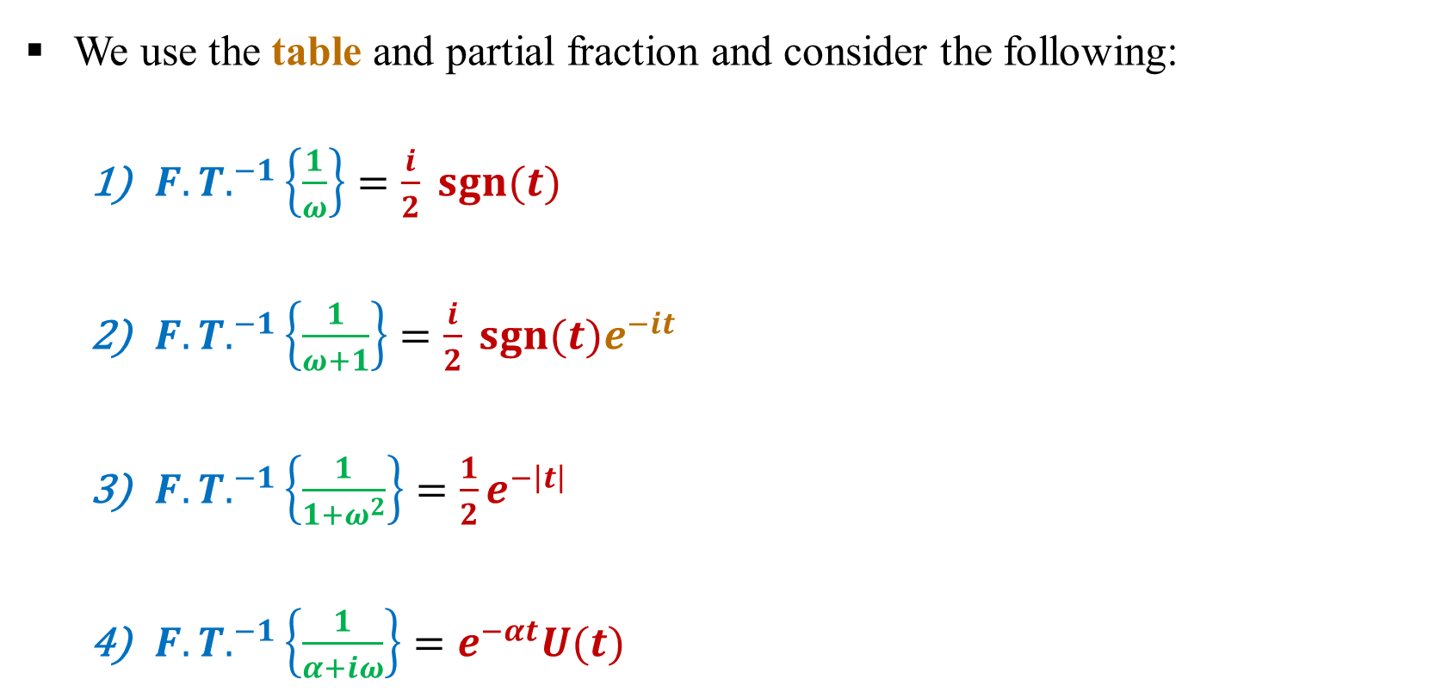
Inverse Fourier Transform
We use the table and partial fraction and consider the following:
${F.T.}^{−1}\left\{\frac{1}{ω}\right\}=\frac{i}{2} sgn⁡(t)$
${F.T.}^{−1}\left\{\frac{1}{ω+1}\right\}=\frac{i}{2} sgn⁡(t)e^{−it}$
${F.T.}^{−1}\left\{\frac{1}{1+ω^{2}}\right\}=\frac{1}{2}e^{−\left|t\right|}$
${F.T.}^{−1}\left\{\frac{1}{α+iω}\right\}=e^{−αt}U⁡(t)$

Slide 24
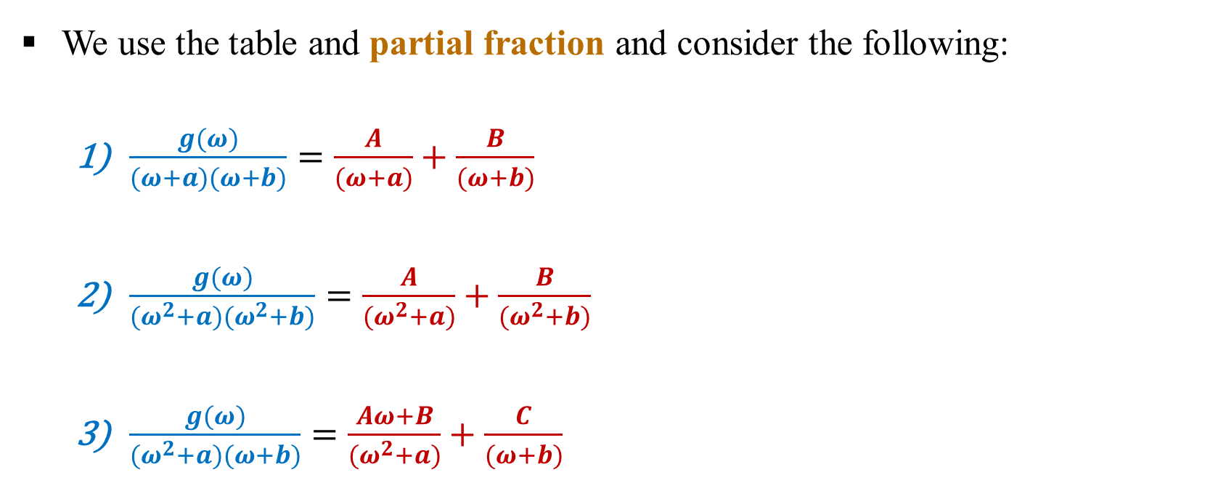
Inverse Fourier Transform
We use the table and partial fraction and consider the following:
$\frac{g(ω)}{(ω+a)(ω+b)}=\frac{A}{(ω+a)}+\frac{B}{(ω+b)}$
$\frac{g(ω)}{(ω^{2}+a)(ω^{2}+b)}=\frac{A}{(ω^{2}+a)}+\frac{B}{(ω^{2}+b)}$
$\frac{g(ω)}{(ω^{2}+a)(ω+b)}=\frac{Aω+B}{(ω^{2}+a)}+\frac{C}{(ω+b)}$

Slide 25
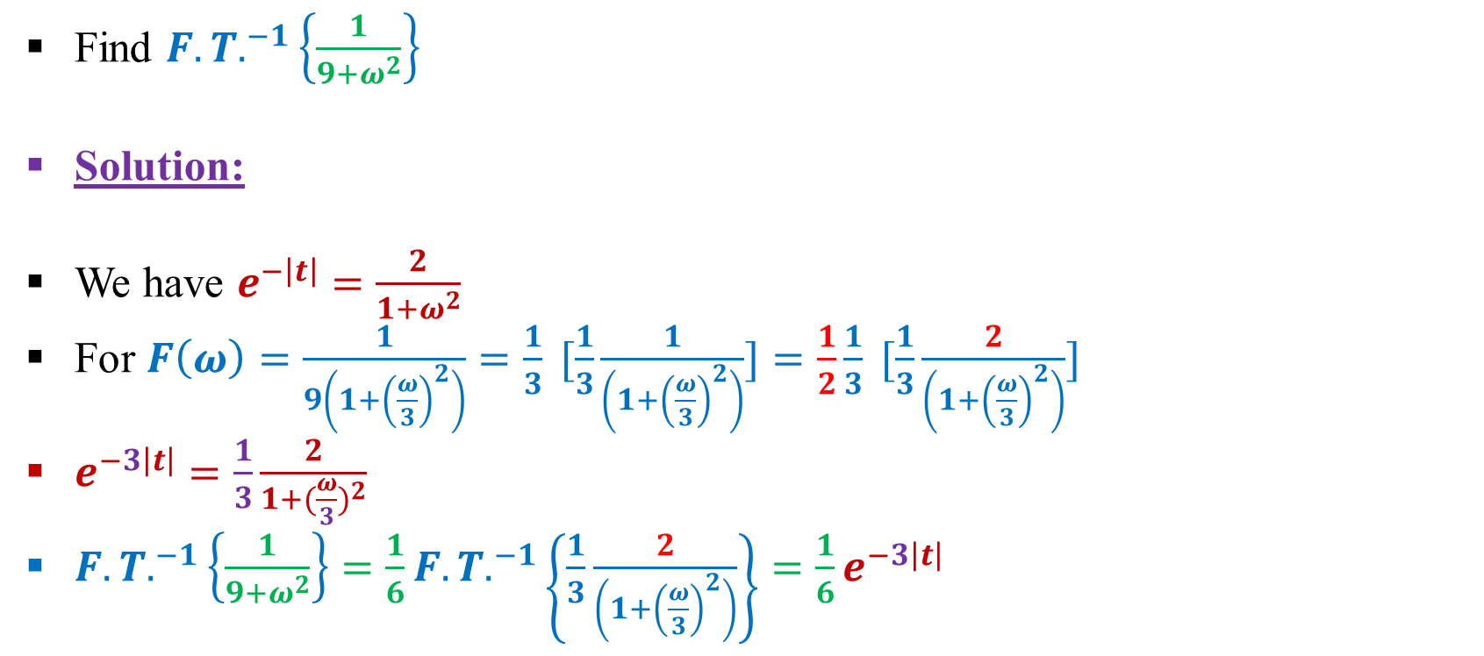
Example:
Find ${F.T.}^{−1}\left\{\frac{1}{9+ω^{2}}\right\}$
Solution:
We have $e^{−\left|t\right|}=\frac{2}{1+ω^{2}}$
For $F\left(ω\right)=\frac{1}{9\left(1+{\left(\frac{ω}{3}\right)}^{2}\right)}=\frac{1}{3} [\frac{1}{3}\frac{1}{\left(1+{\left(\frac{ω}{3}\right)}^{2}\right)}]=\frac{1}{2}\frac{1}{3} [\frac{1}{3}\frac{2}{\left(1+{\left(\frac{ω}{3}\right)}^{2}\right)}]$
$e^{−3\left|t\right|}=\frac{1}{3}\frac{2}{1+{(\frac{ω}{3})}^{2}}$
${F.T.}^{−1}\left\{\frac{1}{9+ω^{2}}\right\}=\frac{1}{6}{F.T.}^{−1}\left\{\frac{1}{3}\frac{2}{\left(1+{\left(\frac{ω}{3}\right)}^{2}\right)}\right\}=\frac{1}{6}e^{−3\left|t\right|}$

Slide 26
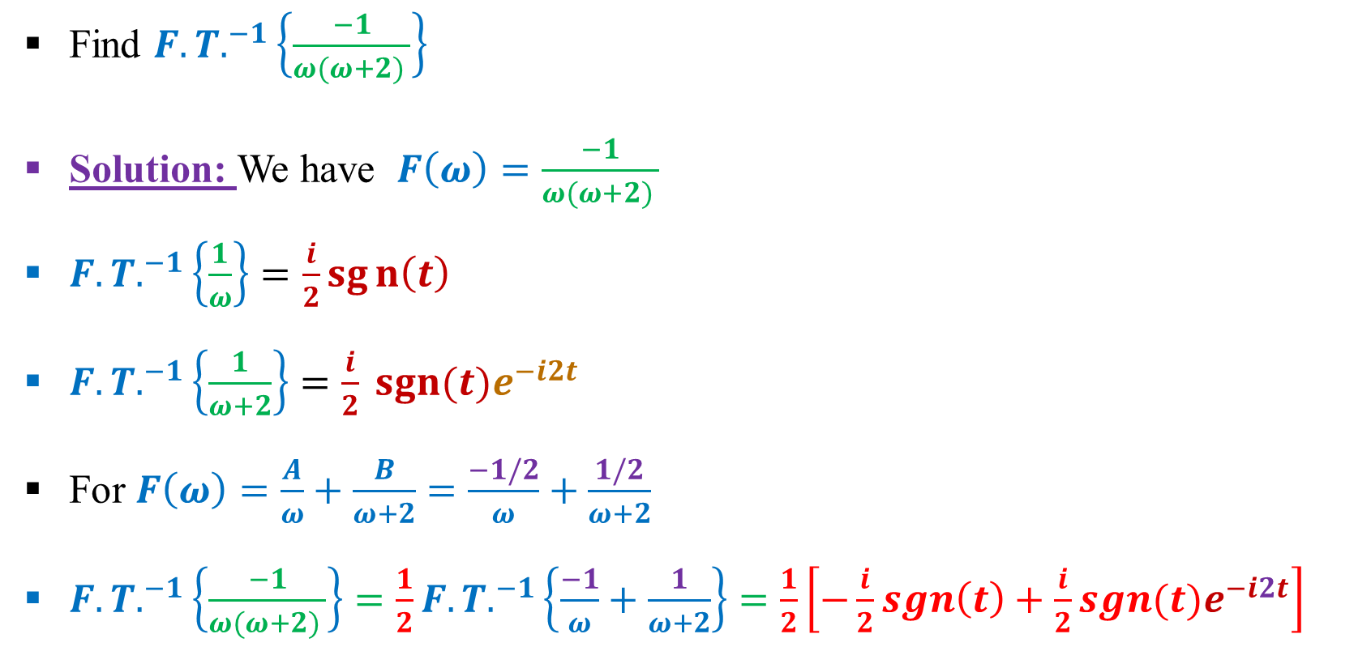
Example:
Find ${F.T.}^{−1}\left\{\frac{−1}{ω(ω+2) }\right\}$
Solution: We have $F\left(ω\right)=\frac{−1}{ω(ω+2) }$
${F.T.}^{−1}\left\{\frac{1}{ω}\right\}=\frac{i}{2}sgn\left(t\right)$
${F.T.}^{−1}\left\{\frac{1}{ω+2}\right\}=\frac{i}{2} sgn⁡(t)e^{−i2t}$
For $F\left(ω\right)=\frac{A}{ω}+\frac{B}{ω+2}=\frac{−1/2}{ω}+\frac{1/2}{ω+2}$
${F.T.}^{−1}\left\{\frac{−1}{ω(ω+2) }\right\}=\frac{1}{2}{F.T.}^{−1}\left\{\frac{−1}{ω}+\frac{1}{ω+2}\right\}=\frac{1}{2}\left[−\frac{i}{2}sgn\left(t\right)+\frac{i}{2}sgn(t)e^{−i2t}\right]$

Slide 27
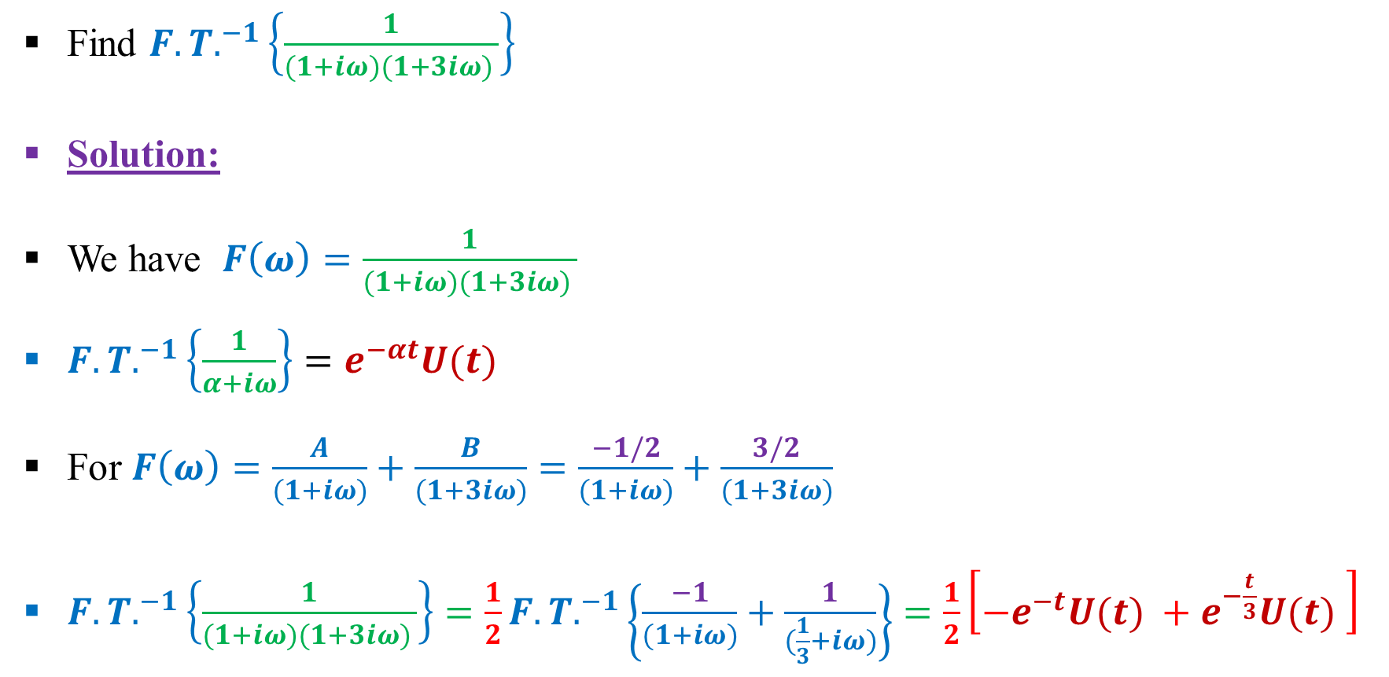
Example:
Find ${F.T.}^{−1}\left\{\frac{1}{(1+iω)(1+3iω) }\right\}$
Solution:
We have $F\left(ω\right)=\frac{1}{(1+iω)(1+3iω) }$
${F.T.}^{−1}\left\{\frac{1}{α+iω}\right\}=e^{−αt}U⁡(t)$
For $F\left(ω\right)=\frac{A}{(1+iω)}+\frac{B}{(1+3iω)}=\frac{−1/2}{(1+iω)}+\frac{3/2}{(1+3iω)}$
${F.T.}^{−1}\left\{\frac{1}{(1+iω)(1+3iω) }\right\}=\frac{1}{2}{F.T.}^{−1}\left\{\frac{−1}{(1+iω)}+\frac{1}{(\frac{1}{3}+iω)}\right\}=\frac{1}{2}\left[−e^{−t}U⁡(t) +e^{−\frac{t}{3}}U⁡(t) \right]$

Slide 28
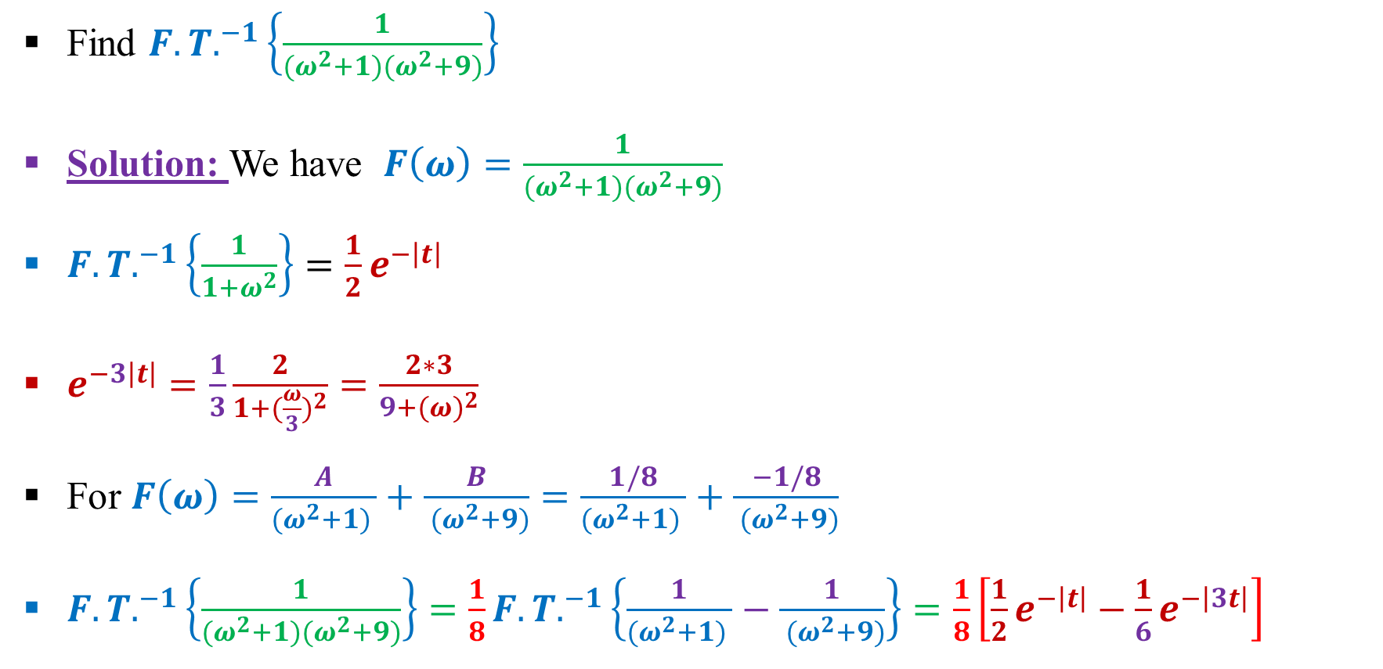
Example:
Find ${F.T.}^{−1}\left\{\frac{1}{(ω^{2}+1)(ω^{2}+9)}\right\}$
Solution: We have $F\left(ω\right)=\frac{1}{(ω^{2}+1)(ω^{2}+9)}$
${F.T.}^{−1}\left\{\frac{1}{1+ω^{2}}\right\}=\frac{1}{2}e^{−\left|t\right|}$
$e^{−3\left|t\right|}=\frac{1}{3}\frac{2}{1+{(\frac{ω}{3})}^{2}}=\frac{2∗3}{9+{(ω)}^{2}}$
For $F\left(ω\right)=\frac{A}{(ω^{2}+1) }+\frac{B}{ (ω^{2}+9)}=\frac{1/8}{(ω^{2}+1) }+\frac{−1/8}{ (ω^{2}+9)}$
${F.T.}^{−1}\left\{\frac{1}{(ω^{2}+1)(ω^{2}+9)}\right\}=\frac{1}{8}{F.T.}^{−1}\left\{\frac{1}{(ω^{2}+1) }−\frac{1}{ (ω^{2}+9)}\right\}=\frac{1}{8}\left[\frac{1}{2}e^{−\left|t\right|}−\frac{1}{6}e^{−\left|3t\right|}\right]$

Slide 29
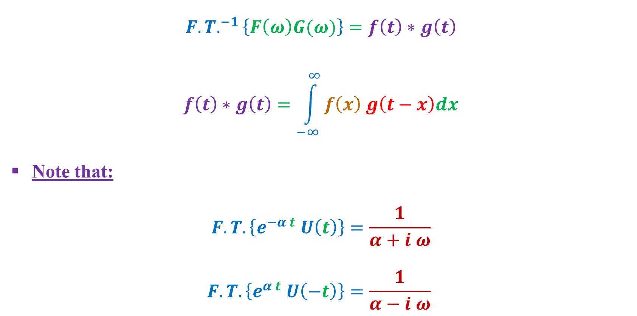
Inverse Fourier Transform Using Convolution
$${F.T.}^{−1}\left\{F\left(ω\right)G(ω)\right\}=f\left(t\right)∗g\left(t\right)$$
$$f\left(t\right)∗g\left(t\right)=\int_{−∞}^{∞}{f\left(x\right) g\left(t−x\right)dx}$$
Note that:
$$F.T.\left\{e^{−α t} U\left(t\right)\right\}=\frac{1}{α+i ω}$$
$$F.T.\left\{e^{α t} U\left(−t\right)\right\}=\frac{1}{α−i ω}$$

Slide 30
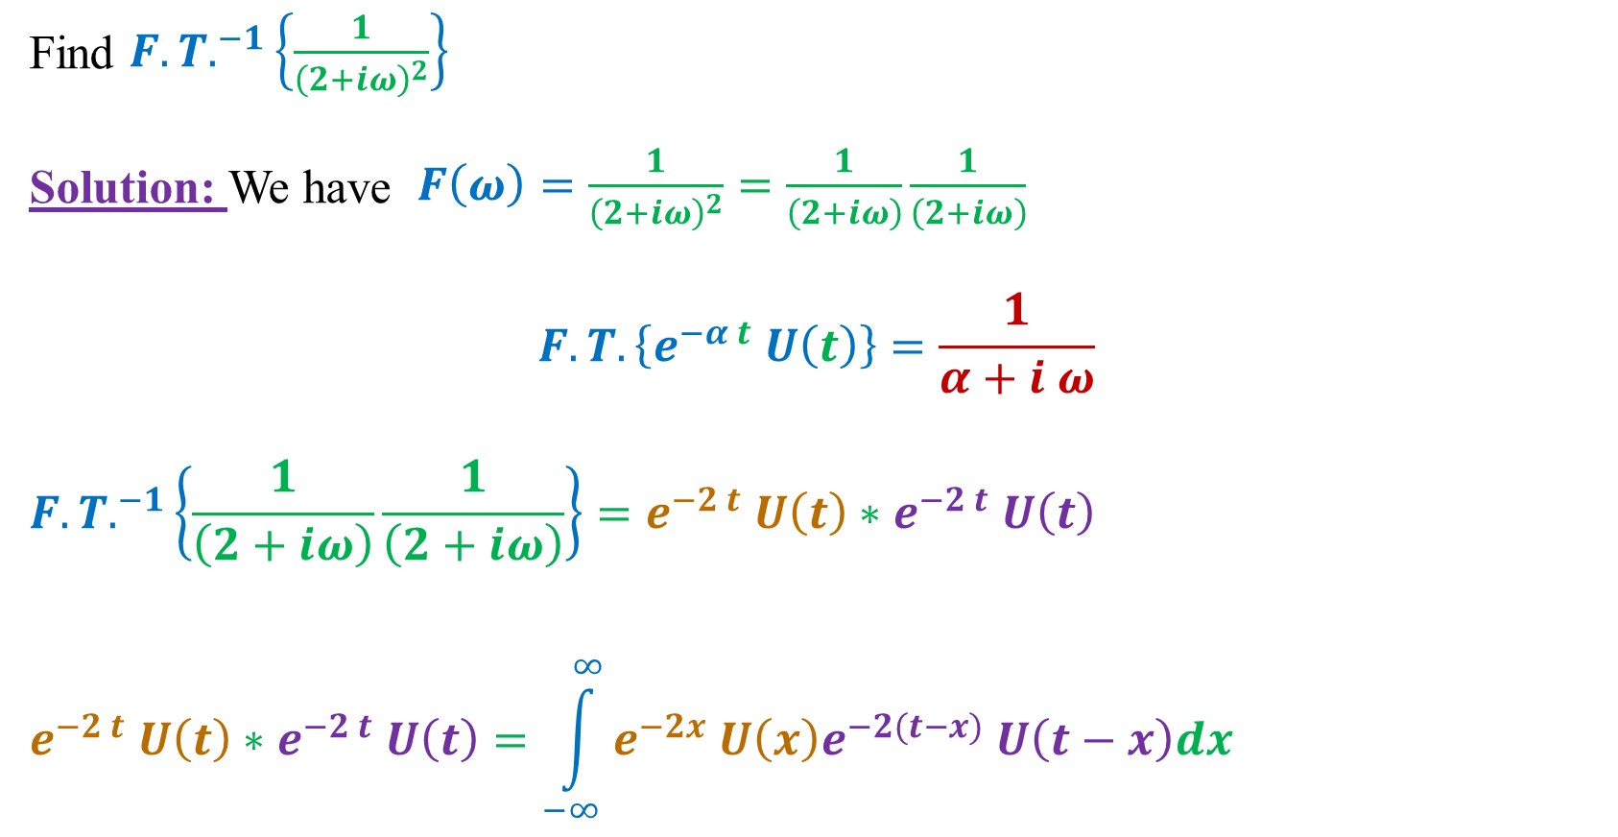
Example:
Find ${F.T.}^{−1}\left\{\frac{1}{{\left(2+iω\right)}^{2}}\right\}$
Solution: We have $F\left(ω\right)=\frac{1}{{\left(2+iω\right)}^{2}}=\frac{1}{\left(2+iω\right)}\frac{1}{\left(2+iω\right)}$
$$F.T.\left\{e^{−α t} U\left(t\right)\right\}=\frac{1}{α+i ω}$$
$${F.T.}^{−1}\left\{\frac{1}{\left(2+iω\right)}\frac{1}{\left(2+iω\right)}\right\}=e^{−2 t} U\left(t\right)∗e^{−2 t} U\left(t\right)$$
$$e^{−2 t} U\left(t\right)∗e^{−2 t} U\left(t\right)=\int_{−∞}^{∞}{e^{−2x} U\left(x\right)e^{−2(t−x)} U\left(t−x\right)dx}$$

Slide 31
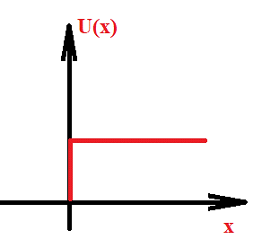
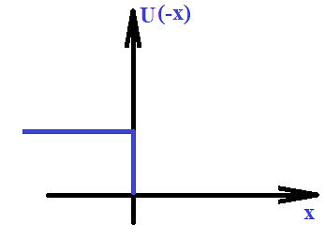
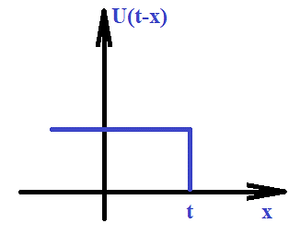
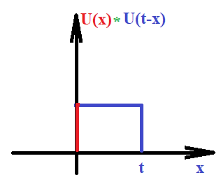
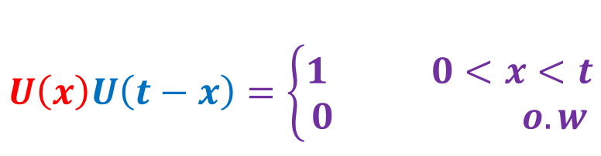
$$U\left(x\right)U\left(t−x\right)=\left\{\begin{aligned}1 0<x<t \\ 0 o.w\end{aligned}\right.$$

Slide 32
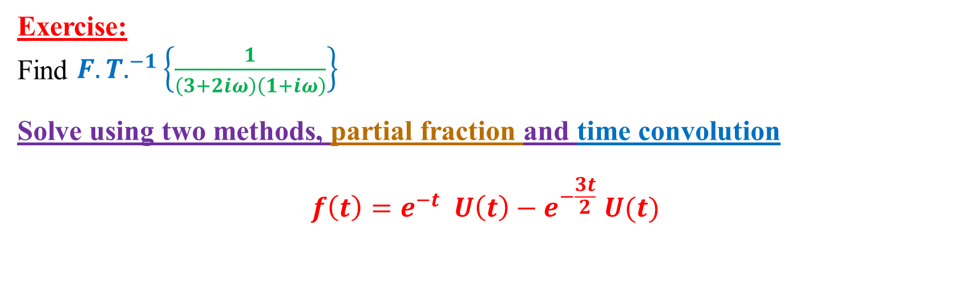


$$e^{−2 t} U\left(t\right)∗e^{−2 t} U\left(t\right)=\int_{0}^{t}{e^{−2x} e^{−2(t−x)} dx}=\int_{0}^{t}{e^{−2t} dx}$$
$${F.T.}^{−1}\left\{\frac{1}{\left(2+iω\right)}\frac{1}{\left(2+iω\right)}\right\}=e^{−2t}{\left[x\right]}_{0}^{t}=e^{−2t} t U(t)$$
Exercise:
Find ${F.T.}^{−1}\left\{\frac{1}{\left(3+2iω\right)\left(1+iω\right)}\right\}$
Solve using two methods, partial fraction and time convolution
$${f\left(t\right)=e}^{−t} U\left(t\right)−e^{−\frac{3t}{2}} U(t)$$

Slide 33

Application of Fourier Transform
Solution of differential Equation:
$$F.T. \left\{f\left(t\right)\right\}=F(ω)$$
$$F.T. \left\{f^{′}\left(t\right)\right\}=i ω F(ω)$$
$$F.T. \left\{f^{′′}\left(t\right)\right\}={\left(i ω\right)}^{2}F(ω)$$
To solve the differential equation we got its Fourier transform and then get $F(ω)$
separated after that we get inverse Fourier transform to get $f\left(t\right)$

Slide 34

Application of Fourier Transform
Solution of integral Equation of convolution type:
$$F.T. \left\{f\left(t\right)\right\}=F(ω)$$
$$F.T. \left\{f_{1}\left(t\right) ∗f_{2}\left(t\right)\right\}⟺F_{1} \left(ω\right){ F}_{2} (ω)$$
Example:
Solve the following integral equation
$$f\left(t\right)−\frac{1}{4} \int_{−∞}^{∞}{e^{−\left|t−x\right|}f\left(x\right)dx}= e^{−\left|t\right|}$$

Slide 35


Solution:
$$f\left(t\right)−\frac{1}{4} \left[e^{−\left|t\right|} ∗f(t)\right]= e^{−\left|t\right|}$$
Taking Fourier Transform for both sides, we got:
$$F\left(ω\right)−\frac{1}{4}\left[\frac{2}{1+ω^{2}}F\left(ω\right) \right]=\frac{2}{1+ω^{2}}$$
$$F\left(ω\right)\left[1−\frac{1}{4}\frac{2}{1+ω^{2}}\right]=\frac{2}{1+ω^{2}}$$
$$F\left(ω\right)\left[1−\frac{1}{2(1+ω^{2})}\right]=\frac{2}{1+ω^{2}}$$

Slide 36









$$F\left(ω\right)\left[\frac{2+2ω^{2}−1}{2(1+ω^{2})}\right]=\frac{2}{1+ω^{2}}$$
$$F\left(ω\right)\left[\frac{1+2ω^{2}}{2(1+ω^{2})}\right]=\frac{2}{1+ω^{2}}$$
$$F\left(ω\right)=\frac{4}{1+2ω^{2}}$$
$$f\left(a t\right)=\frac{1}{\left|a\right|}F\left(\frac{ω}{a}\right)$$
$$F.T. \left\{e^{−a\left|t\right|}\right\}=\frac{1}{a}\frac{2}{1+{(\frac{ω}{a})}^{2}}=\frac{2a}{a^{2}+ω^{2}}$$
$$F\left(ω\right)=\frac{2}{\frac{1}{2}+ω^{2}}$$
$$F.T. \left\{e^{−\frac{\left|t\right|}{\sqrt{2}}}\right\}=\frac{2\frac{1}{\sqrt{2}}}{\frac{1}{2}+ω^{2}}$$
$$a=\frac{1}{\sqrt{2}}$$
$$f\left(t\right)={F.T.}^{−1}\left\{\frac{4}{1+2ω^{2}}\right\}=\sqrt{2 }e^{−\frac{\left|t\right|}{\sqrt{2}}}$$

